Slide 1
Transmission Lines
Engineering Electromagnetics

Slide 2
Introductions
Let us familiarize

Slide 3
Course thus far
Vector Analysis Electrostatics Electric field in matter Magnetostatics
Magnetic field in matter Electrodynamics Conservation laws Electromagnetic waves
So, we already know about the time varying Maxwell’s Equations and Electromagnetic waves in a media

Slide 4
Topics we will study
Transmission lines fundamentals
Smith Charts
Impedance matching
Waveguides
Antennas
Electric Machines
Books
Field and wave electromagnetics. Cheng, David K. 2nd Ed. Engineering
Electromagnetics – William Hayt, John Buck – 8 ed – McGraw Hill
Electromagnetics – with Applications – 5 ed – Kraus/Fleisch – McGraw Hill

Slide 5
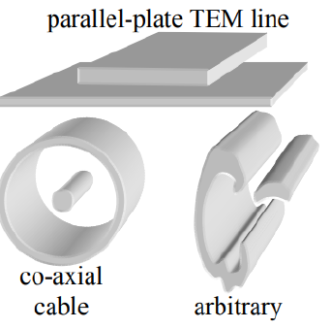
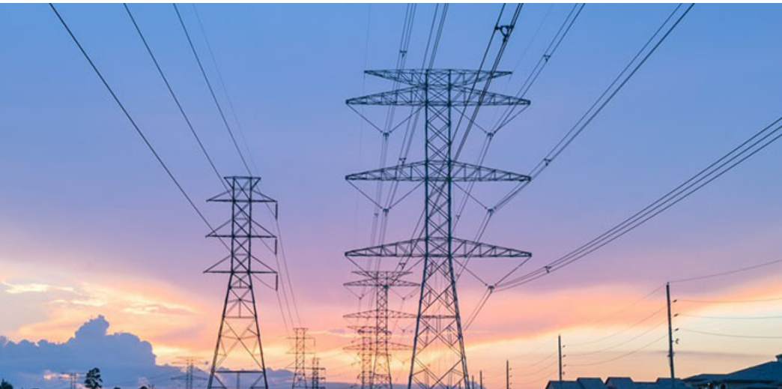
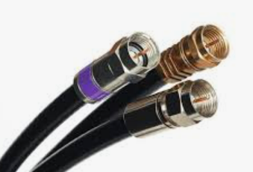
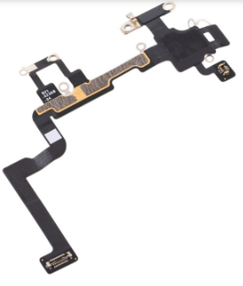
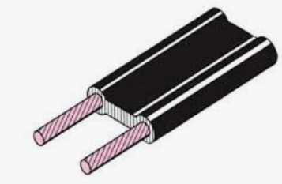
Transmission lines (TLs)
Power lines
Coaxial cable
I-phone Wi-Fi antenna cable
Twin-wire TV Antenna cable

Slide 6
Transmission lines
Transmission lines are used to transmit electric energy and signals from one point to another, specifically from a source to a load.
Examples include
The connection between a transmitter and an antenna
Connections between computers in a network
Connections between a hydroelectric generating plant and a substation several hundred miles away.

Slide 7
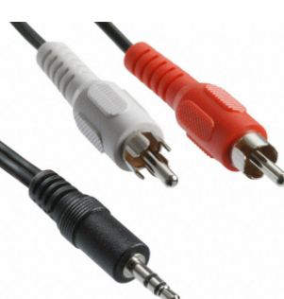
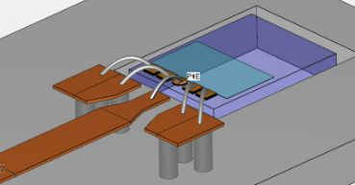
Transmission lines
Other familiar examples include the interconnects between components of a stereo system
Connection between a cable service provider and your television set.
Examples that are less familiar include the connections between devices on a circuit board that are designed to operate at high frequencies.

Slide 8
What is there to consider?
Consider a signal frequency of 1 Hertz and calculate the wavelength. The wavelength is around 3,00,000 km.
This condition enabled us, for example, to take for granted that the voltage across a resistor on one side of a circuit was exactly in phase with the voltage source on the other side, or, more generally, that the time measured at the source location is precisely the same time as measured at all other points in the circuit.
What all examples we saw before have in common is that the devices to be connected are separated by distances on the order of a wavelength or much larger.

Slide 9
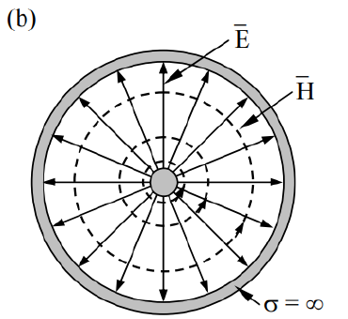
What is there to consider?
When distances are sufficiently large between source and receiver, time delay effects become appreciable, leading to delay-induced phase differences.
In short, we deal with wave phenomena on transmission lines in the same manner that we deal with point-to-point energy propagation in free space or in dielectrics.

Slide 10
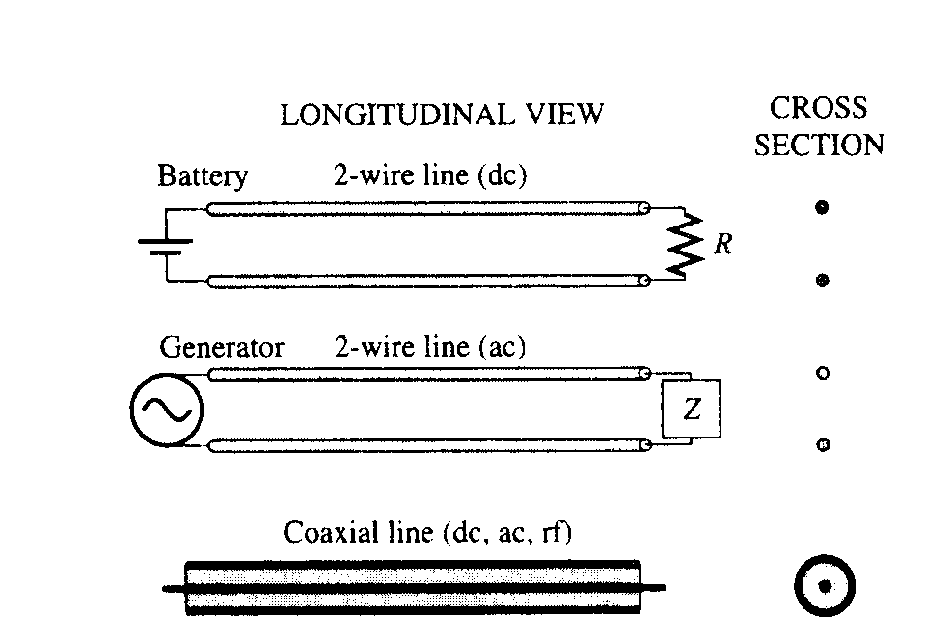
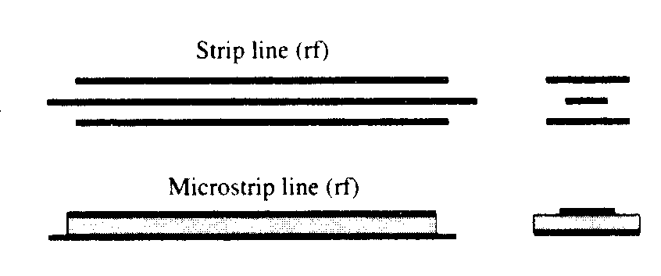
More examples of TLs

Slide 11
Important points to note:
Two pieces of metal can accumulate attractive charges between them, giving rise to capacitive coupling, electric field, and hence stored energy in the electric field.
A piece of wire carrying a current generates a magnetic field, and hence, yielding stored energy in the magnetic field.

Slide 12
Important points to note:
The stored energies are the sources of the capacitive and inductive effects. But these capacitive and inductive effects are distributed over the spatial dimension of the transmission line.
Therefore, it is helpful to think of the two pieces of metal as consisting of small segments of metal segments concatenated together.
Each of these segments will have a small inductance, as well as a small capacitive coupling between them. Hence, we can model two pieces of metal with a distributed lumped element model

Slide 13
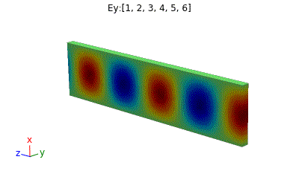
Propagation inside a Waveguide
Port2
Port1
TE10 mode propagation in a rectangular Waveguide

Slide 14
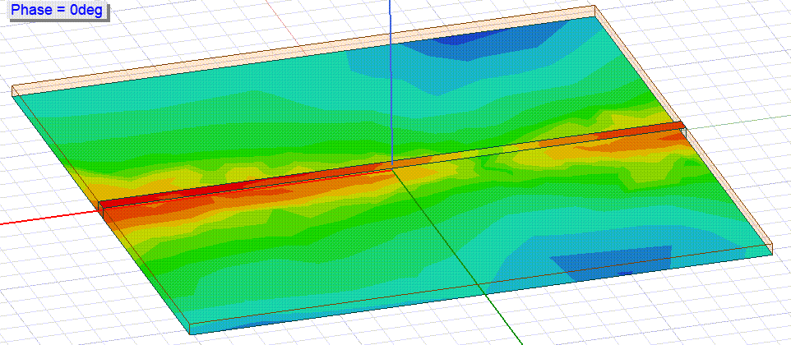
Propagation in transmission lines
Port2
Port1
Surface current in microstripline

Slide 15
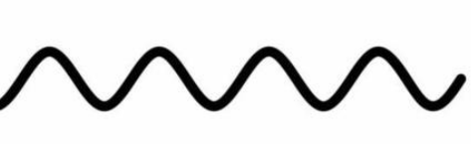
Electrical Circuit Equivalent
https://www.youtube.com/watch?v=ozeYaikI11g&t=90s
R should be selected so that there are no wave reflections

Slide 16
Electrical Circuit Equivalent
https://www.youtube.com/watch?v=ozeYaikI11g&t=90s

Slide 17
Transmission Line Equations
Since, we know that there is a wave travelling across the transmission line that create voltages and currents, we should seek:
what is the relation between the field and circuit parameters ?
Our first goal is to obtain the differential equations, known as the wave equations, which the voltage or current must satisfy on a uniform transmission line.
To do this, we construct a circuit model for an incremental length of line, write two circuit equations, and use these to obtain the wave equations.

Slide 18
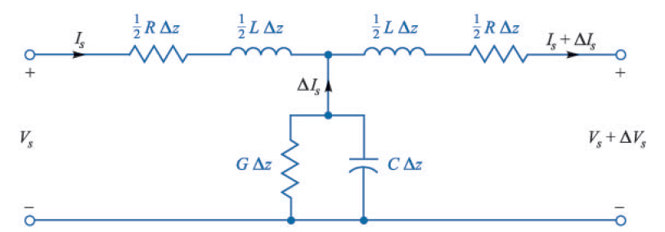
Transmission Line Equations
Note: Parameters R, L, G, and c are per unit length of TL.
R: series resistance; G shunt conductance
Note the symmetry
From previous discussion we know that line can be treated as L and C components, but why G and R?
Losses!

Slide 19
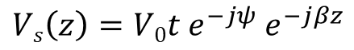
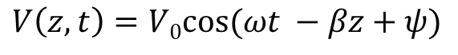
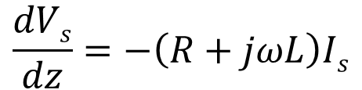
Let us assume sinusoidal variation in the excited wave, as we found for solutions for wave equation:
$$V\left(z,t\right)=V0cos⁡(ωt −βz+ψ)$$
If we transform this voltage into a phasor representation, we have:
$$Vs\left(z\right)=V0t e^{−jψ} e^{−jβz}$$
From Previous circuit of TL, lets write the KVL equations:
$$Vs\left(z\right)=\left(\frac{1}{2}R∆z+j\frac{1}{2}L∆z\right)Is+\left(\frac{1}{2}R∆z+j\frac{1}{2}L∆z\right)(Is+ ∆Is)+Vs+ΔVs$$
As we let $∆z$ approach zero, $∆Is$ also approaches zero and the second term on the right vanishes. In the limit: (note the ordinary differential)
$$\frac{dVs}{dz}=−\left(R+jωL\right)Is$$

Slide 20
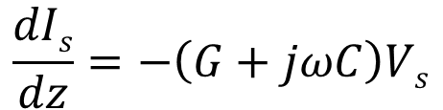
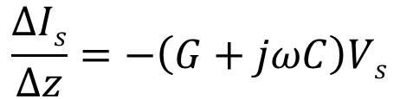
Similarly
$$\frac{∆Is}{∆z}=−\left(G+jωC\right)Vs$$
$$\frac{dIs}{dz}=−\left(G+jωC\right)Vs$$
Please note that the differentials used are ordinary differentials, this is because we have assumed the time harmonic behavior for the voltage and current. This allows us to convert otherwise partial differential equations to ordinary ones

Slide 21
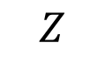
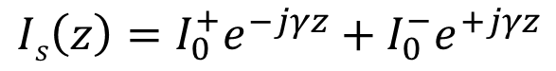
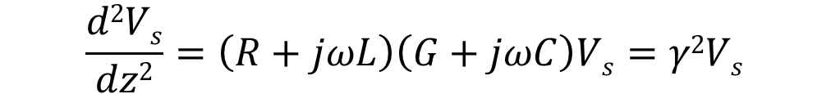
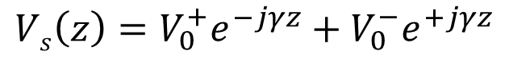
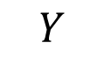
$$\frac{d2Vs}{dz2}=\left(R+jωL\right)\left(G+jωC\right)Vs=γ2Vs$$
$$Z$$
$$Y$$
where Z and Y, as indicated, are respectively the net series impedance and the net shunt admittance in the transmission line-both as per-unit-distance measures. The propagation constant in the line is defined as
$$γ=\sqrt{\left(R+jωL\right)\left(G+jωC\right)}=\sqrt{ZY}=α+jβ$$
The solution for the above second order ordinary differential equations is:
$$Vs\left(z\right)=V_{0}^{+}e^{−jγz}+V_{0}^{−}e^{+jγz}$$
$$Is\left(z\right)=I_{0}^{+}e^{−jγz}+I_{0}^{−}e^{+jγz}$$

Slide 22
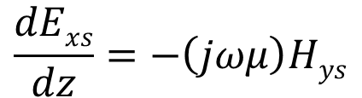
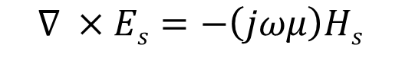
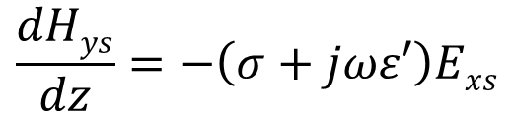

Alternatively, instead of solving these equations, let us save some time by comparing them with the equations which arise from Maxwell's curl equations for the uniform plane wave in a conducting medium. From
we set E_{s} = E_{xs} a_{x} and H_{s} = H_{ys}a_{y}, where E_{xs} and H_{ys} are functions of z only, and obtain a scalar equation:
Similarly, from
Using previous analogy
$$∇ ×Es=−\left(jωμ\right)Hs$$
$$\frac{dExs}{dz}=−\left(jωμ\right)Hys$$
$$∇ ×Hs=−\left(σ+ jωε′\right)Es$$
$$\frac{dHys}{dz}=−\left(σ+jωε′\right)Exs$$

Slide 23
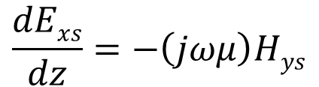
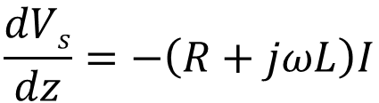

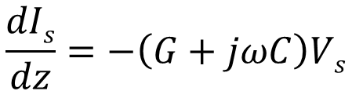
On comparison
$$\frac{dVs}{dz}=−\left(R+jωL\right)I$$
$$\frac{dExs}{dz}=−\left(jωμ\right)Hys$$
$$\frac{dIs}{dz}=−\left(G+jωC\right)Vs$$
$$\frac{dHys}{dz}=−\left(σ+jωε′\right)Exs$$
Direct analogy between:
$$Is and Hys, G and σ, C and ε^{′}, Vs and Exs, L and μ$$

Slide 24
What about the term R, we don’t see it here: It relates to solution of Maxwell’s equation inside the conductor, shows losses due to finite conductivity. Omitted here for simplicity.
The boundary conditions on V_{s} and E_{xs} are the same, as are those for I_{s} and H_{ys}, and thus the solution of our two circuit equations may be obtained from a knowledge of the solution of the two field equations, as obtained in the last chapter. We can obtain the voltage wave as:
$Exs=Ex0e^{−jkz}$ (considering no backward wave)
We obtain the voltage wave as:
$Vs=V0e^{−jkz}$ (considering no backward wave)

Slide 25
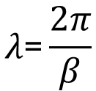
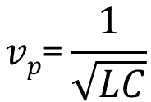
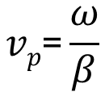
The wavelength of the excited voltage wave is defined as distance required for 2$π$ phase change, therefore
$$λ\text{=}\frac{2π}{β}$$
The phase velocity is defined as
$$vp\text{=}\frac{ω}{β}$$
The above expressions are valid for both uniform plane wave and transmission lines. For a lossless line (R = G = 0), therefore
$$γ=jβ=jω\sqrt{LC}$$
$$vp\text{=}\frac{1}{\sqrt{LC}}$$

Slide 26
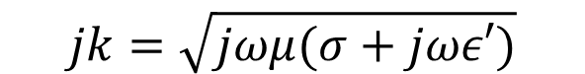
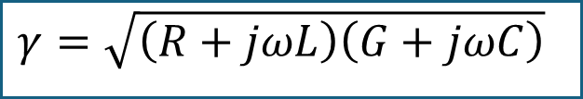
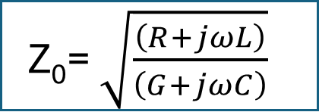
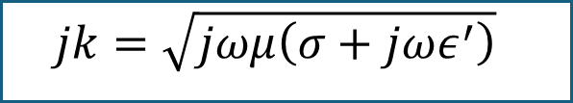
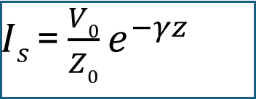
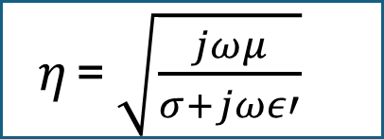
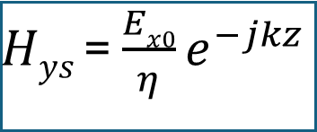
The wave propagates in the +z direction with an amplitude V_{s} = V₀ at z = 0 (and V = V₀ at z = 0, t = 0 for y = 0). The propagation constant for the uniform plane wave is:
$$jk=\sqrt{jωμ(σ+jωε′)}$$
$$jk=\sqrt{jωμ\left(σ+jωε^{′}\right)}$$
$$γ=\sqrt{\left(R+jωL\right)\left(G+jωC\right)}$$
$Hys$= $\frac{Ex0}{η}e^{−jkz}$
$Is$= $\frac{V0}{Z0}e^{−γz}$
$η$= $\sqrt{\frac{jωμ}{σ+jωε′}}$
Z₀= $\sqrt{\frac{\left(R+jωL\right)}{\left(G+jωC\right)}}$

Slide 27
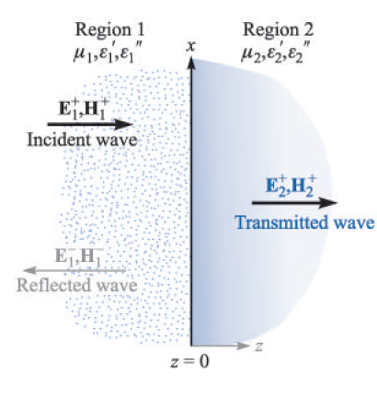
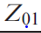
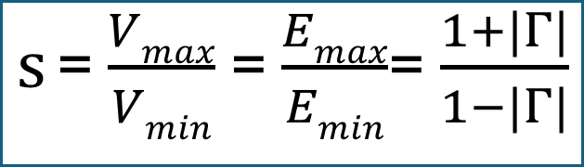
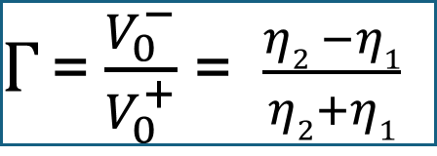
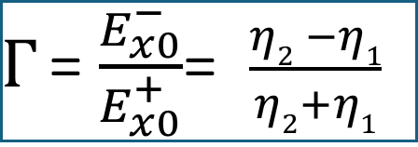
$Γ$= $\frac{E_{x0}^{−}}{E_{x0}^{+}}$= $\frac{η2 −η1}{η2+η1}$
$Γ$= $\frac{V_{0}^{−}}{V_{0}^{+}}$ = $\frac{η2 −η1}{η2+η1}$
$s$= $\frac{Vmax}{Vmin}$ = $\frac{Emax}{Emin}$= $\frac{1+|Γ|}{1−|Γ|}$

Slide 28
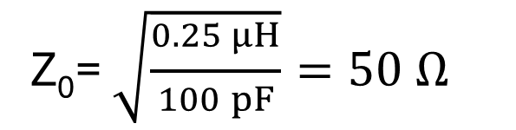
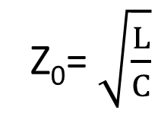
Example
A lossless transmission line is 80 cm long and operates at a frequency of 600 MHz. The line parameters are L = 0.25 μH/m and C = 100 pF/m. Find the characteristic impedance, the phase constant, the velocity on the line, and the input impedance for Z_{L} = 100 Ω.
Solution:
Since the line is lossless (R = G = 0)
Therefore
Z₀= $\sqrt{\frac{L}{C}}$
Z₀= $\sqrt{\frac{\begin{aligned}0.25 μH \\ \end{aligned}}{100 pF}}=50 Ω$
$$γ=\sqrt{\left(R+jωL\right)\left(G+jωC\right)}= jω\sqrt{LC}$$
$$β= ω\sqrt{LC} =2π\left(600×106\right)\sqrt{0.25 μH×100 pF}=18.85 rad/m$$

Slide 29
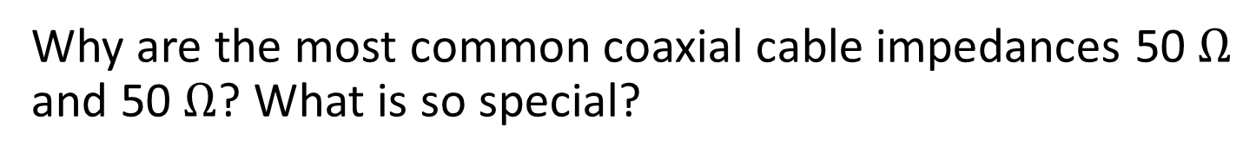
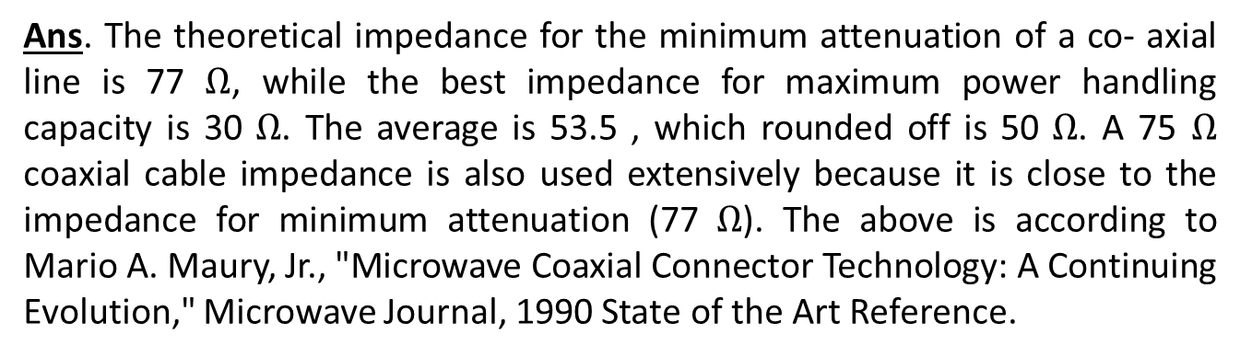
Why are the most common coaxial cable impedances 50 $Ω$ and 50 $Ω$? What is so special?
Ans. The theoretical impedance for the minimum attenuation of a co- axial line is 77 $Ω$, while the best impedance for maximum power handling capacity is 30 $Ω$. The average is 53.5 , which rounded off is 50 $Ω$. A 75 $Ω$ coaxial cable impedance is also used extensively because it is close to the impedance for minimum attenuation (77 $Ω$). The above is according to Mario A. Maury, Jr., "Microwave Coaxial Connector Technology: A Continuing Evolution," Microwave Journal, 1990 State of the Art Reference.

Slide 30
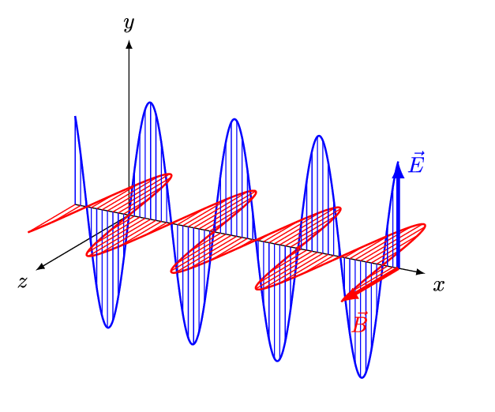
Wave Animation: Where is the power flow?
Phase Velocity?
What is more fundamental: Frequency or wavelength?

Slide 31





Case-1: Lossless Line (R = 0, G = 0)
Propagation Constant
$$γ=α+jβ=jω\sqrt{LC}$$
$$α=0$$
$$β=jω\sqrt{LC} ∝ ω$$
Phase Velocity
$$vp=\frac{1}{\sqrt{LC}}$$
Independent of frequency
Characteristic Impedance
$$Z0=R0+jX0=jω\sqrt{LC}$$

Slide 32






Case-2: Low-Loss Line (R << jωL, G << jωC)
Propagation Constant
Find the value for attenuation and phase constant
$γ=α+jβ=jω\sqrt{LC}$ ${(\text{1+}\frac{R}{jωL})}^{\frac{1}{2}}{(\text{1+}\frac{G}{jωC})}^{\frac{1}{2}}$
$≅jω\sqrt{LC}$ $(\text{1+}\frac{R}{j2ωL})(\text{1+}\frac{G}{j2ωC})$
$≅jω\sqrt{LC}$ $[\text{1+}\frac{1}{j2ω}(\frac{R}{L}\text{+}\frac{G}{C})]$
$$α≅\frac{1}{2} (\text{R}\sqrt{\frac{C}{L}}+\text{G}\sqrt{\frac{L}{C}} )$$
$$β≅jω\sqrt{LC}$$
Approx. $∝ω$

Slide 33






Phase Velocity
$$vp≅\frac{1}{\sqrt{LC}}$$
Approximately constant
Characteristic Impedance
$$Z0=R0+jX0=jω\sqrt{\frac{L}{C}}{(\text{1+}\frac{R}{jωL})}^{\frac{1}{2}}{(\text{1+}\frac{G}{jωC})}^{−\frac{1}{2}}$$
$$≅jω\sqrt{\frac{L}{C}}(\text{1+}\frac{R}{j2ωL})(\text{1}−\frac{G}{j2ωC})$$
$$≅jω\sqrt{\frac{L}{C}}[\text{1+}\frac{1}{j2ω}(\frac{R}{L}\text{-}\frac{G}{C})]$$
$$R0=\sqrt{\frac{L}{C}}$$
$X0≅$ $\frac{1}{j2ω}\left(\frac{R}{L}\text{−}\frac{G}{C}\right)≅0$

Slide 34






Case-3: Distortion-less (R / L = G / C)
Propagation Constant
$$γ=α+jβ=jω\sqrt{(R+jωL)(\frac{RC}{L}+jωC)}$$
$$γ=\sqrt{\frac{C}{L}}(R+jωL)$$
$$α=R\sqrt{\frac{C}{L}}$$
$$β=ω\sqrt{LC}$$
$$β∝ω$$
$$vp=\frac{1}{\sqrt{LC}}$$
Phase Velocity
constant

Slide 35




Characteristic Impedance
$$Z0=R0+jX0=jω\sqrt{\frac{R+jωL}{\frac{RC}{L}+jωC}}= \sqrt{\frac{L}{C}}$$
$$R0= \sqrt{\frac{L}{C}}$$
$$X0=0$$
Non-zero attenuation constant
Phase constant is linear function of frequency
Phase velocity is fixed and independent of frequency
Since the attenuation factor is independent of frequency, when a group of frequency is transmitted through TL all of them get attenuated by same factor but there is no dependence on frequency.
Have you observed a distorted signal?

Slide 36
TL line of arbitrary length and arbitrary load.
Derivation of input impedance for this condition

Slide 37

Study of Finite Transmission Line:
l
I_{in}
I_{L}
V_{in}
($γ$, Z₀)
Z_{L}
V_{L}
z
z’ =l-z
Z_{in}
z =l
z =0

Slide 38



$$Z\left(z′\right)=Z_{0}\frac{Z_{L}+Z_{0}\tanh{γ}z′}{Z_{0}+Z_{L}\tanh{γ}z′}$$
At source end, z’ = l, generator will see the line as input impedance
$$Z_{in}=Z_{0}\frac{Z_{L}+Z_{0}\tanh{γ}l}{Z_{0}+Z_{L}\tanh{γ}l}$$
Input impedance
l
Z_{g}
~
Z_{in}
($γ$, Z₀)
Z_{L}
V_{g}
Z_{in}
z
l-z
Z_{in}

Slide 39




lossless
$$Z_{in}=Z_{0}\frac{Z_{L}+Z_{0}\tanh{γ}l}{Z_{0}+Z_{L}\tanh{γ}l}$$
$$Z_{in}=R_{0}\frac{Z_{L}+jR_{0}\tan{β}l}{R_{0}+jZ_{L}\tan{β}l}$$
$$Z_{in}=50\frac{100+j50\tan{(18.85∗0.8)}}{50+j100\tan{(18.85}∗0.8)}$$
$$Z_{in}=49.1+j35 Ω$$
$$Z_{in}=60.3 ∠ 35.5o$$

Slide 40
Transmission line as circuit elements
TLs also find uses other than as transmission structure
At high frequencies: 300 MHz and higher, lumped elements are difficult to handle due to stray fields.
At these frequencies, small sections of TLs can be used as reactive components in RF/microwave circuits. Often termed as stubs.
Such assumption is valid for line length < λ/4
l
l
Z₀
Z₀
Open-ended stub
Shorted stub
Notes:
Alternatively, when long section of transmission lines are present, they can be miniaturized using lumped elements, while the parasitic effects are compensated/adjusted.

Slide 41



Examples of TL stubs in circuits
GND
Helps us to tune-in or tune out frequency bands
E.g. Harmonic rejection stubs:
If OC at f, SC at 2f (filters out)
Wideband applications use radial open-stubs
Notes:
Non-linear devices produce harmonics, that should be filtered else ? Distortion

Slide 42









Case-1: Open Circuited TL
$$Z_{in}=R_{0}\frac{Z_{L}+jR_{0}\tan{β}l}{R_{0}+jZ_{L}\tan{β}l}$$
$$Z_{L}→∞$$
inductive
$$Z_{io}=−jR_{0}\cot{β}l$$
$$βl≪1$$
$\tan{βl}$ ~ $βl$
$$Z_{io}=−j\frac{\sqrt{L/C}}{ω\sqrt{LC} l}$$
capacitive
$$Z_{io}=−j\frac{1}{ωCl}$$
$$Ceff=Cl$$

Slide 43






Case-2: Short Circuit Termination
$$Z_{in}=R_{0}\frac{Z_{L}+jR_{0}\tan{β}l}{R_{0}+jZ_{L}\tan{β}l}$$
$$Z_{L}=0$$
inductive
$$βl≪1$$
$\tan{βl}$ ~ $βl$
$Z_{is}=−j$ $\sqrt{\frac{L}{C} ∗ω\sqrt{LC}}$l
capacitive
$$Z_{io}=−jωLl$$
$$Leff=Ll$$

Slide 44





Alternatively,
$$Zo=\sqrt{\frac{L}{C}}$$
$$L=\frac{Z0}{v}$$
$$C= \frac{1}{Z0v}$$
$$v=\frac{1}{\sqrt{LC}}$$
Example: It I given that the dielectric constant housing the transmission line is 3.55. Where as, the characteristic impedance is 100 Ohms. Calculate the per unit capacitance and inductance if this is used as tuning stub. Assume line length << quarter wavelength.
$$v=\frac{c}{\sqrt{ε′}}$$

Slide 45





Case-3: Quarter Wave or $\frac{λ}{4}$ Section
$$l=\left(2n−1\right)\frac{λ}{4}; βl=\left(2n−1\right)\frac{π}{2}$$
$$\tan{β}l→±∞$$
n = +ve integer
$$Z_{in}=\frac{R_{0}^{2}}{Z_{L}}$$
$$Z_{in}=R_{0}\frac{Z_{L}+jR_{0}\tan{β}l}{R_{0}+jZ_{L}\tan{β}l}$$
An open-circuited, quarter wave line inverts the impedance behavior at the load to a short circuit at the input terminals. Similar inversion happen for short circuited line.

Slide 46




Case-4: Half Wave Section
$$l=n\frac{λ}{2}; βl=nπ$$
$$\tan{β}l=0$$
n = +ve integer
$$Z_{in}=R_{0}\frac{Z_{L}+jR_{0}\tan{β}l}{R_{0}+jZ_{L}\tan{β}l}$$
$$Z_{i}=Z_{L}$$
A Half wave lossless line simply transfers the load impedance to the input terminals.

Slide 47


How to calculate the TL parameters using terminal voltage , currents and loads
Open Circuit line
Spen Circuit line
$$Z_{0}=\sqrt{Z_{io}Z_{is}} \left(Ω\right)$$
$$γ=\frac{1}{l}\tanh^{−1}{\sqrt{\frac{Z_{is}}{Z_{io}}}} \left(m^{−1}\right)$$

Slide 48






Example problem
The open circuit and short circuit impedances measured at the input terminals of a very low loss TL of length 1.5 meter (less than quarter-wavelength) are –j56.6 and j103 Ohms respectively.
Find the characteristic impedance and the propagation constant.
Find input impedance of SC line twice the given length at the same frequency. (put l = 3m)
How long should the SC line be so that it appears an open circuit at the input terminals.
$$Z_{o}=75 Ohm$$
$$γ=0.628 rad/m$$
$$Z_{is}=jR_{0}\tan{β}l=−j231$$
$L=\frac{λ}{4}$ + (n-1) $\frac{λ}{2}$
$$λ =\frac{2π}{β}=10m$$
$L=2.5m$ + 5(n-1)

Slide 49





Line with Resistive Termination
$$R_{L}≠R_{0}$$
$$V\left(z′\right)=\frac{I_{L}}{2}\left[\left(Z_{L}+Z_{0}\right)e^{γz′}+\left(Z_{L}−Z_{0}\right)e^{−γz′}\right] \\ I\left(z′\right)=\frac{I_{L}}{2Z_{0}}\left[\left(Z_{L}+Z_{0}\right)e^{γz′}−\left(Z_{L}−Z_{0}\right)e^{−γz′}\right]$$
$$V\left(z′\right)=\frac{I_{L}}{2}\left(Z_{L}+Z_{0}\right)e^{γz′}\left[1+Γe^{−2γz′}\right] \\ I\left(z′\right)=\frac{I_{L}}{2Z_{0}}\left(Z_{L}+Z_{0}\right)e^{γz′}\left[1−Γe^{−2γz′}\right]$$
$$Γ=\frac{\left(Z_{L}−Z_{0}\right)}{\left(Z_{L}+Z_{0}\right)}=\left|Γ\right|e^{jθ_{Γ}}$$
Ratio of the complex amplitudes of the reflected and incident voltage waves at load end
Voltage reflection coefficient
$$Γ_{i}=\frac{I_{0}^{−}}{I_{0}^{+}}=−\frac{V_{0}^{−}}{V_{0}^{+}}=−Γ_{V}=−Γ$$

Slide 50






For lossless TL
$$V\left(z′\right)=\frac{I_{L}}{2}\left(Z_{L}+Z_{0}\right)e^{jβz′}\left[1+\left|Γ\right|e^{j\left(θ_{Γ}−2βz′\right)}\right] \\ I\left(z′\right)=\frac{I_{L}}{2Z_{0}}\left(Z_{L}+Z_{0}\right)e^{jβz′}\left[1−\left|Γ\right|e^{j\left(θ_{Γ}−2βz′\right)}\right]$$
$$Γ=\frac{\left(Z_{L}−Z_{0}\right)}{\left(Z_{L}+Z_{0}\right)}=\left|Γ\right|e^{jθ_{Γ}}$$
$$R_{L}>R_{0}$$
The reflection coefficient is positive and $θ_{Γ}$ = 0. At the load side, a voltage maxima and a current minima will be created. Other maxima for voltage is created at $2βz=2nπ$ from the load. Similar but inverted observation for current.
$$R_{L}<R_{0}$$
The reflection coefficient is negative and $θ_{Γ}$ = $−π$. At the load side, a voltage minima and a current maxima will be created. Other minima for voltage is created at $z′=nλ/2$ from the load. Similar but inverted observation for current.

Slide 51





Standing Wave Ratio
$$S=\frac{\left|V_{max}\right| }{\left|V_{min}\right|}$$
$$=\frac{1+\left|Γ\right|}{1−\left|Γ\right|}$$
Ratio of the maximum to minimum voltages along a finite TL
$$\left|Γ\right|=\frac{S−1}{S+1}$$

